Slide 1
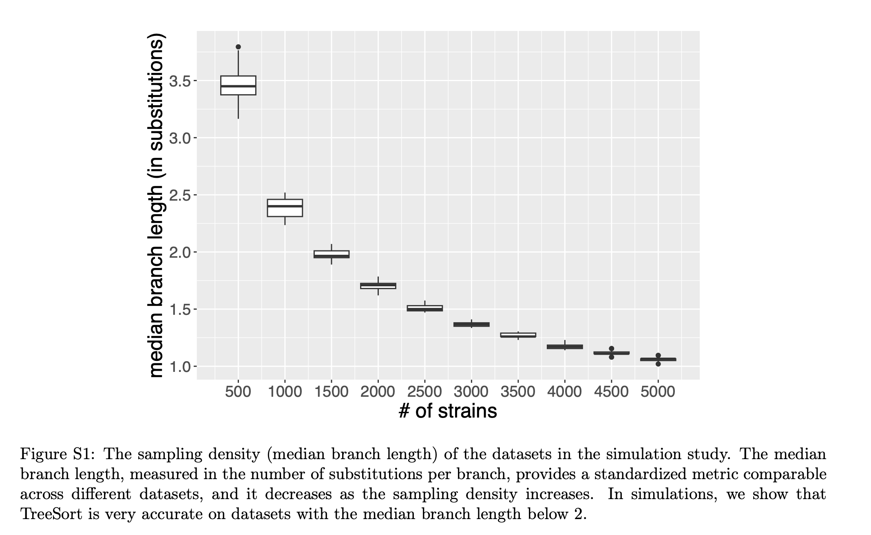
Recap: median substitutions per branch

Slide 2
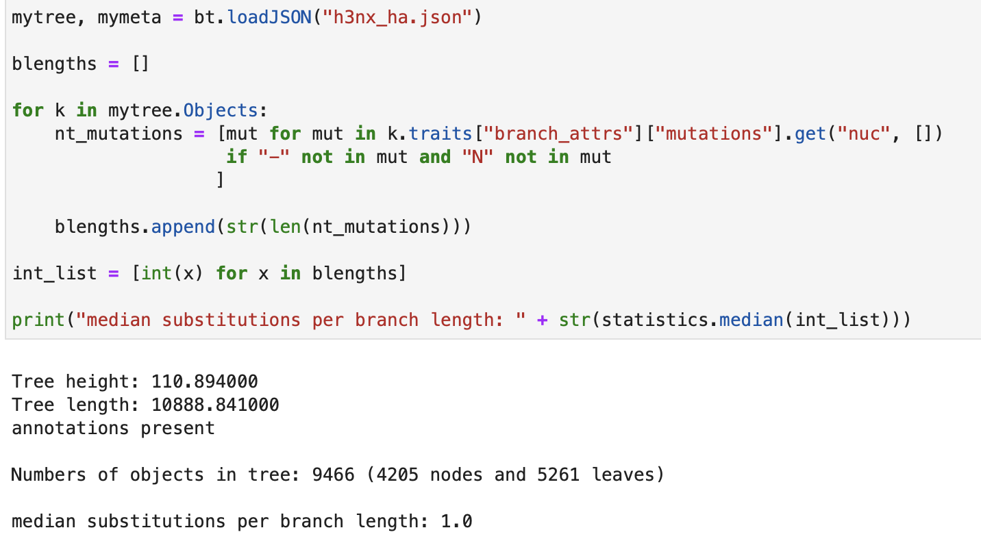
For the whole tree:

Slide 3
For each subtree – all below 2
'Equine': ['1’]
'Canine': ['0’]
‘NA Avian': [‘1’]
“Eurasian Avian’: [‘2’]
‘Euro Swine': [‘2’]
‘NA Swine’ : [‘2’]
'Human': ['2.0’]
Notes:
fprce include more euro samples for clades with 2

